Slide 1
Insights from Airbnb Analysis from Pre-COVID Period
Audience – Lead Data Analyst
Notes:
Objective

Slide 2
AGENDA
Objective
Background
Key findings
Recommendations
Appendix:
Data sources
Data methodology
Data model assumptions
Notes:
Objective

Slide 3
OBJECTIVE
Understand the behavioral pattern of customer with respect to price and geographical locations.
Analysis relationship of customer preference with price, quality and customer experience.
Identifying patterns in the buying behavior of the customer with respect to property types and locations.
Notes:
Objective

Slide 4
BACKGROUND
Hospitality market in US alone is estimated at $234 billion in 2024 and expected to reach $300 billion by 2029.
Global Smart Hospitality Market is estimated at $13.6 billion and projected to reach $50 billion by 2027.
Market is forecasted to grow at 29.8% for next 5 years.
Notes:
Objective

Slide 5
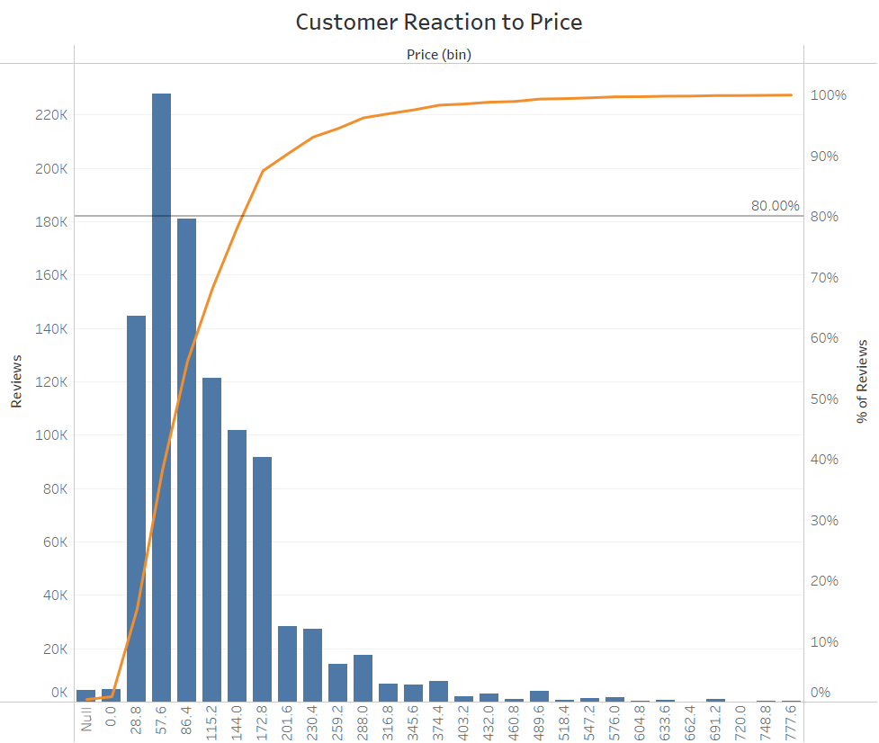
CUSTOMER BEHAVIOUR WITH RESPECT TO PRICE
We can observe here 80% of the customer traction is between $28 - $144 range. Rest 20% traction is in above $144 range.
Notes:
Objective

Slide 6
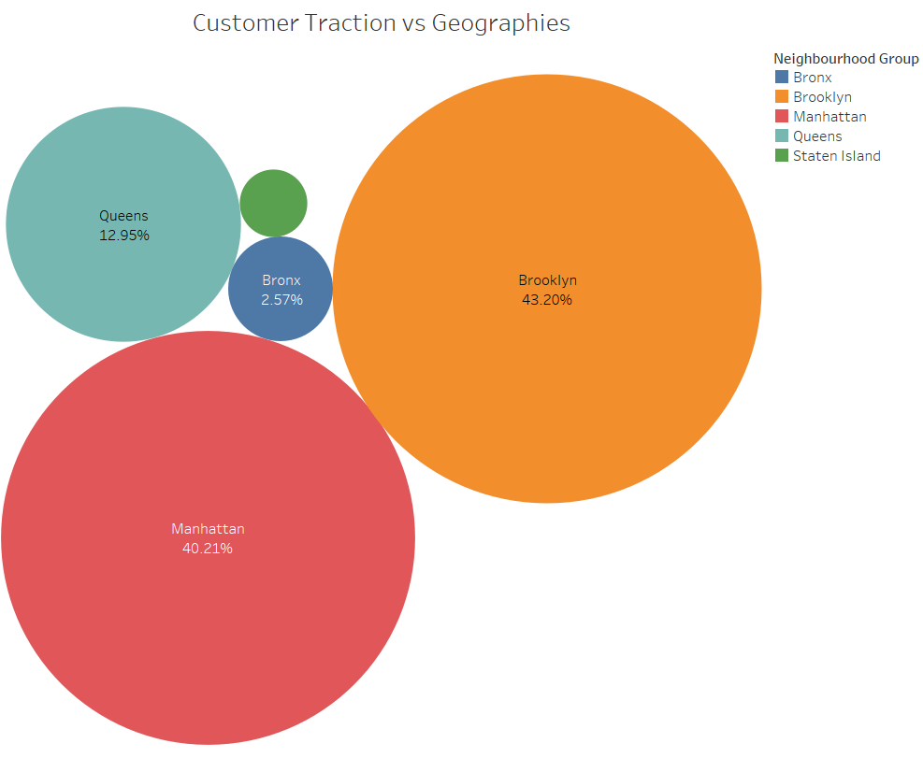
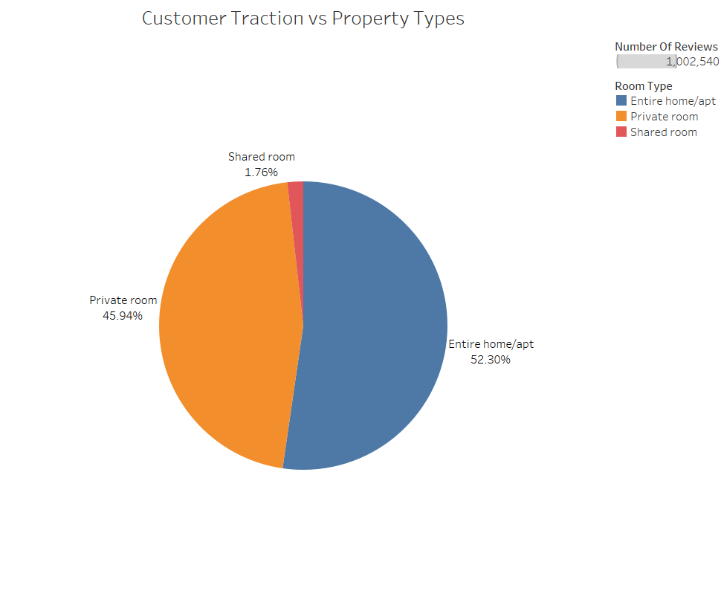
CUSTOMER BEHAVIOR WITH RESPECT TO GEOGRAPHIES AND PROPERTY TYPES
Brooklyn and Manhattan are popular locations by a large margin with Brooklyn claiming 43.2% of total customer traction and Manhattan 40.2%.
Entire Home Apartment is the most popular property type with more than 50% of total customer traction followed by private rooms with 46%.
Notes:
Objective

Slide 7
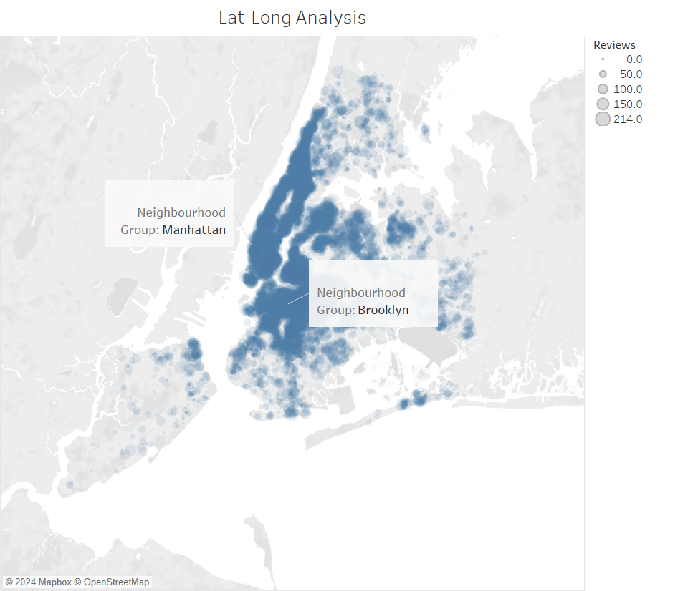
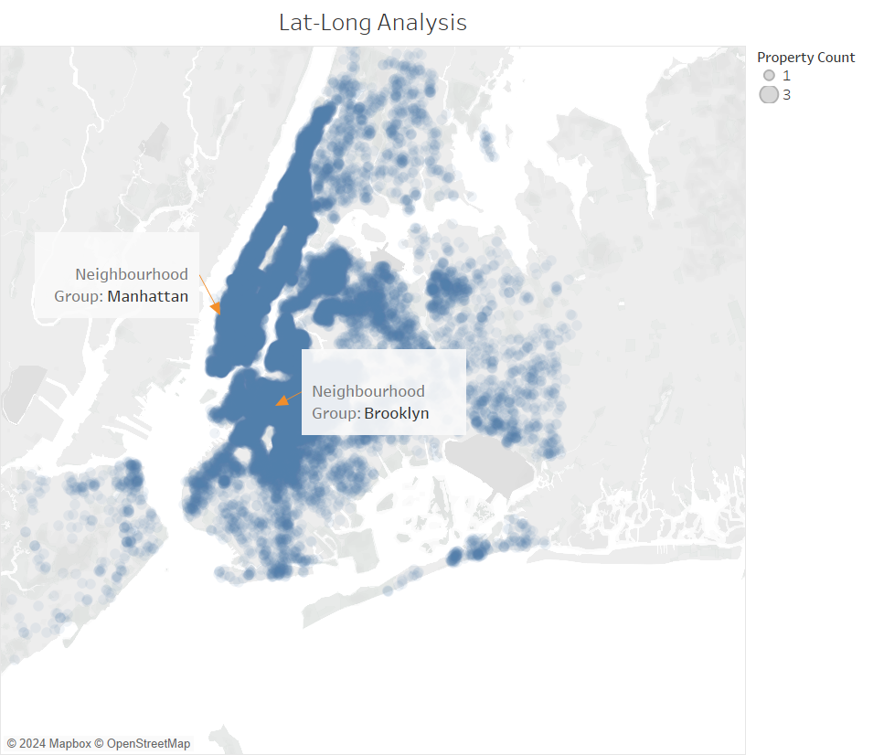
Supply and Demand Analysis
We can observe that the supply of properties are cluttered more in and around Manhattan and Brooklyn areas.
We can map the traction by reviews and observe it is highest in the Manhattan and Brooklyn areas as denoted by the geographical heat map.

Slide 8
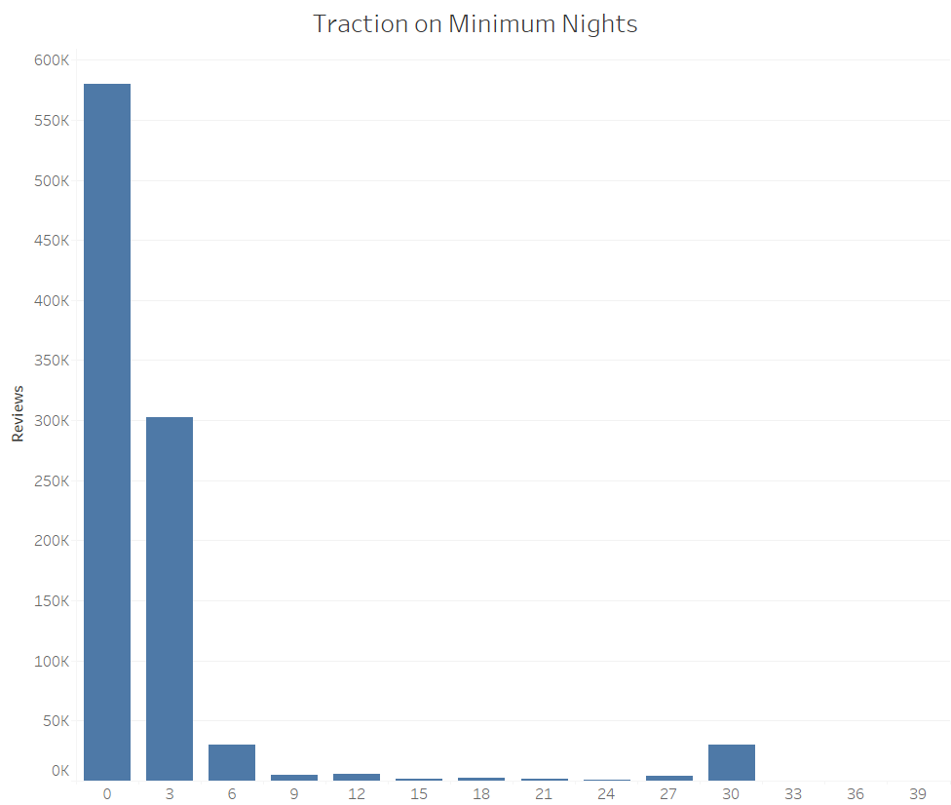
CUSTOMER BEHAVIOR WITH RESPECT TO ROOM FEATURES
Properties where minimum nights feature is 0-6 are seeing maximum traction. However as also observed supply of properties is maximum at this range of minimum night feature.
Notes:
Objective

Slide 9
RECOMMENDATIONS
Supply of Shared Room properties is very low compared to other property types throughout the city. Increasing acquisition of these properties can target low ticket size customers and increase revenue significantly.
It is observed that almost 78% of the listings on the platform are owned by hosts who own atleast one entire apartment property. Acquiring more of these hosts would increase listings on the platform and also expand variety in options for customers.
Supply is running very low in Staten Island area(not even 1% of the total supply) although the average price in this area is at par with the other locations apart from Manhattan and the average reviews per property is highest in this location. Ramping up supply in this neighbourhood could mean tapping into an untapped market.
Notes:
Objective

Slide 10
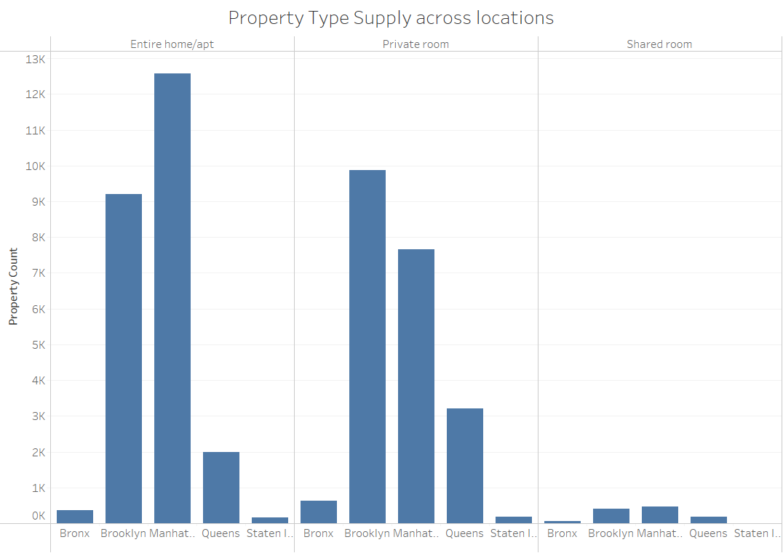
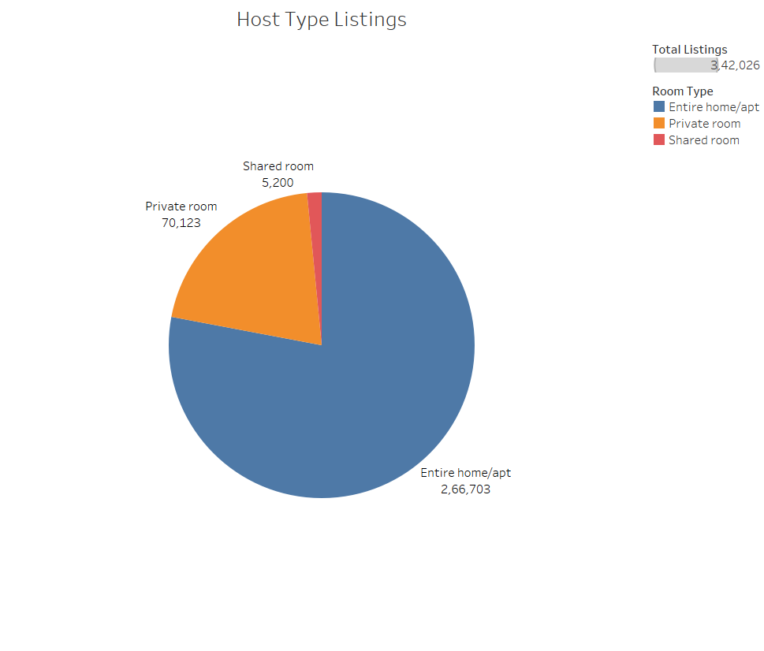
VISUALS SUPPORTING MY RECOMMENDATIONS
Notes:
Objective

Slide 11
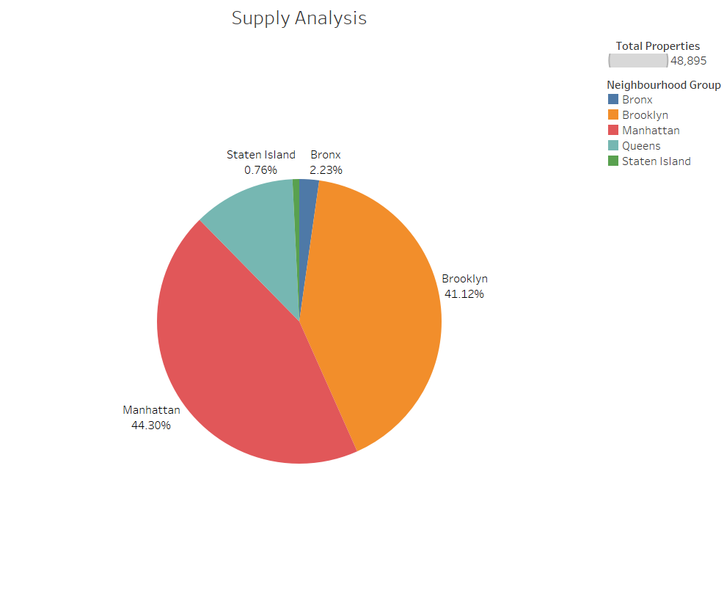
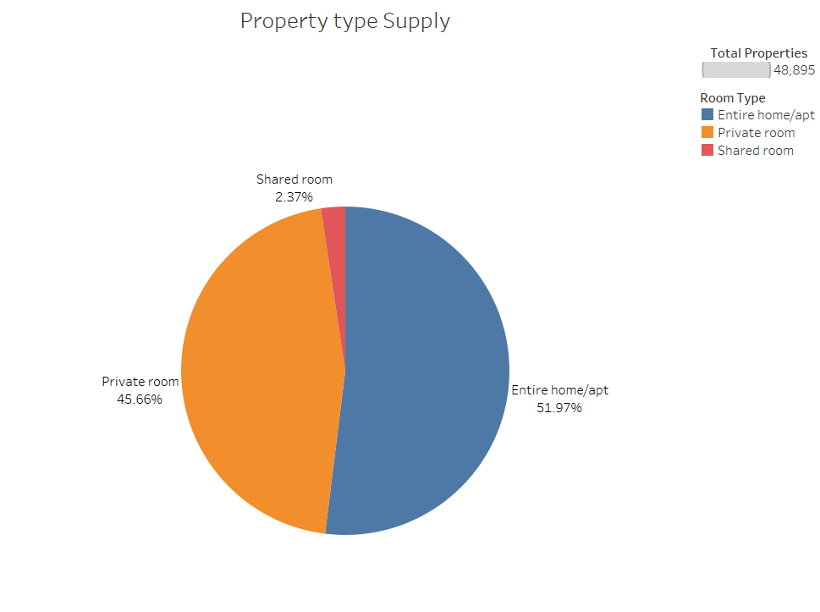
VISUALS SUPPORTING MY RECOMMENDATIONS
Notes:
Objective

Slide 12
APPENDIX - DATA SOURCES:
Here is a snapshot of our data dictionary.
Metadata on host and property types such as location, area, locality, type of property.
Fact information like price, reviews per month, availability, number of listings.
The team used the following data sources:
Airbnb New York Data.
Notes:
Objective

Slide 13
APPENDIX - DATA METHODOLOGY & ASSUMPTIONS
Please refer to the attached Methodology Document
Notes:
Objective

